Slide 1


DIABETES PREDICTION ANALYSIS with SQL
Presented by : shalini sharma

Slide 2
Overview
This project entails the comprehensive management and analysis of a dataset containing vital information pertaining to diabetes patients. Its core objective revolves around optimizing the dataset for effective utilization through meticulous data cleaning, transformation, and structured storage. The initial phase involves stringent data cleansing procedures to eliminate duplicate entries and mitigate the impact of missing or erroneous data points.
Furthermore, careful consideration is given to data type conversions to align with analytical requirements and enhance computational efficiency. The culminating step involves the establishment of a robust database infrastructure using PostgreSQL via pgAdmin 4, facilitating seamless storage, retrieval, and manipulation of the refined dataset. This infrastructure not only serves as a centralized repository for comprehensive data management but also lays the foundation for in-depth analysis, insightful reporting, and informed decision-making in the domain of diabetes research and healthcare management.

Slide 3
DIABETES PREDICATION ASSESSMENT QUESTIONS

Slide 4
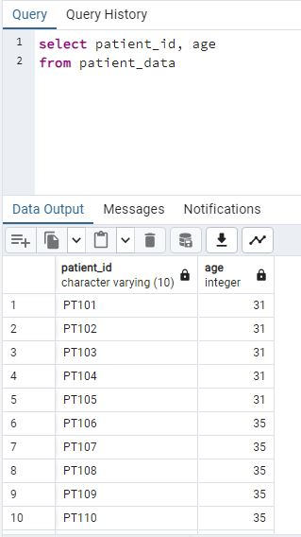
1. Retrieve the Patient_id and ages of all patients.

Slide 5
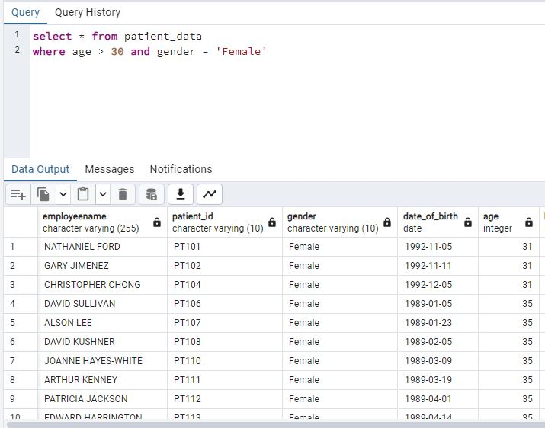
2. Select all female patients who are older than 30.

Slide 6
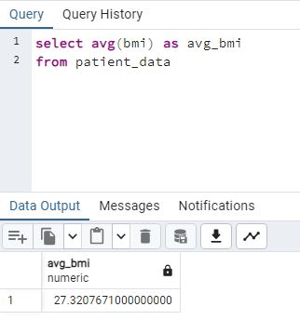
3. Calculate the average BMI of patients.

Slide 7
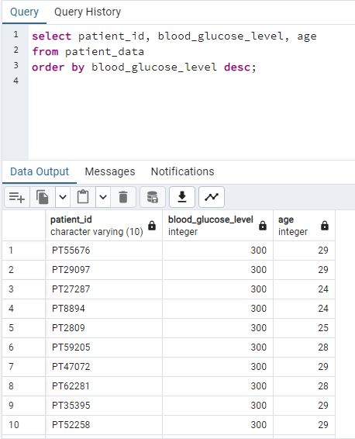
4. List patients in descending order of blood glucose levels.

Slide 8
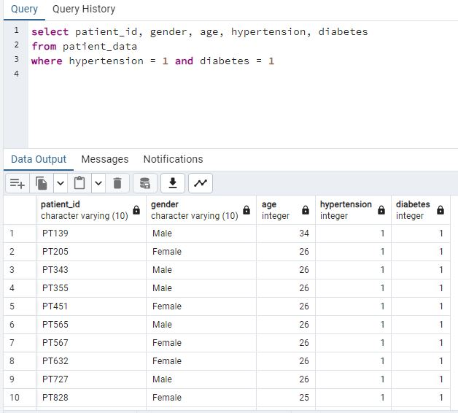
5. Find patients who have hypertension and diabetes.

Slide 9
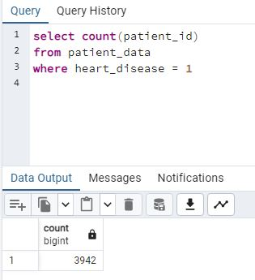
6. Determine the number of patients with heart disease.

Slide 10
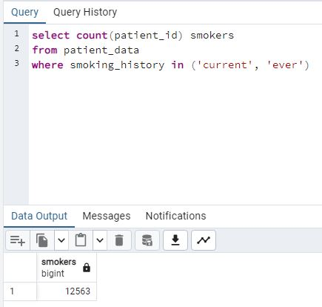
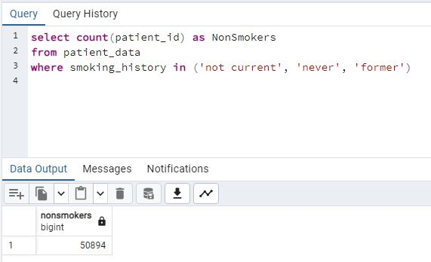
7. Group patients by smoking history and count how many smokers and non-smokers there are.

Slide 11
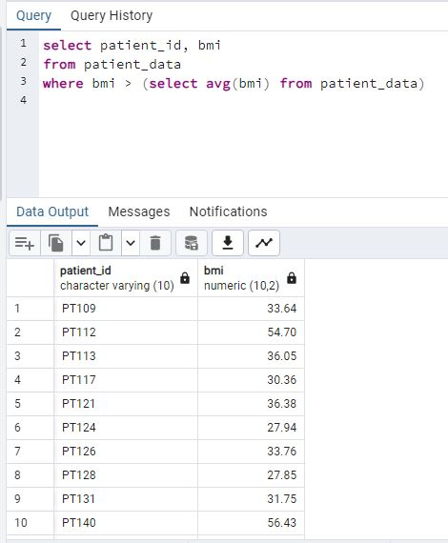
8. Retrieve the Patient_id of patients who have a BMI greater than the average BMI.

Slide 12
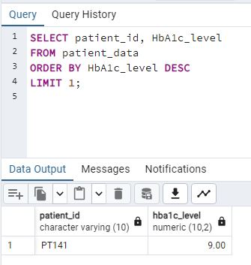
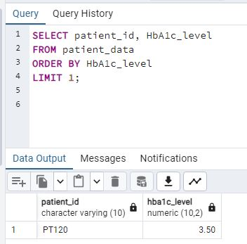
9. Find the patient with the highest HbA1c level and the patient with the lowest HbA1clevel.

Slide 13
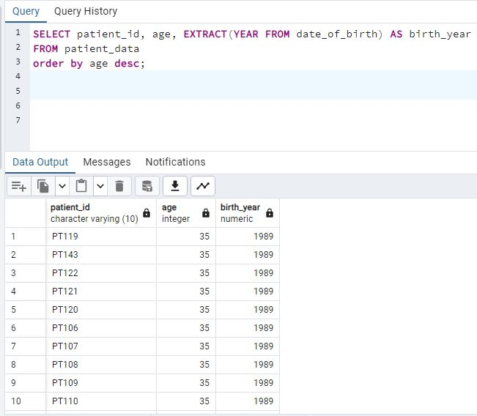
10. Calculate the age of patients in years (assuming the current date as of now).

Slide 14
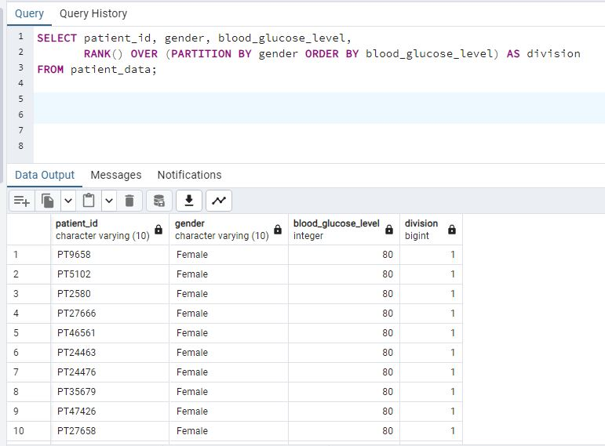
11. Rank patients by blood glucose level within each gender group.

Slide 15
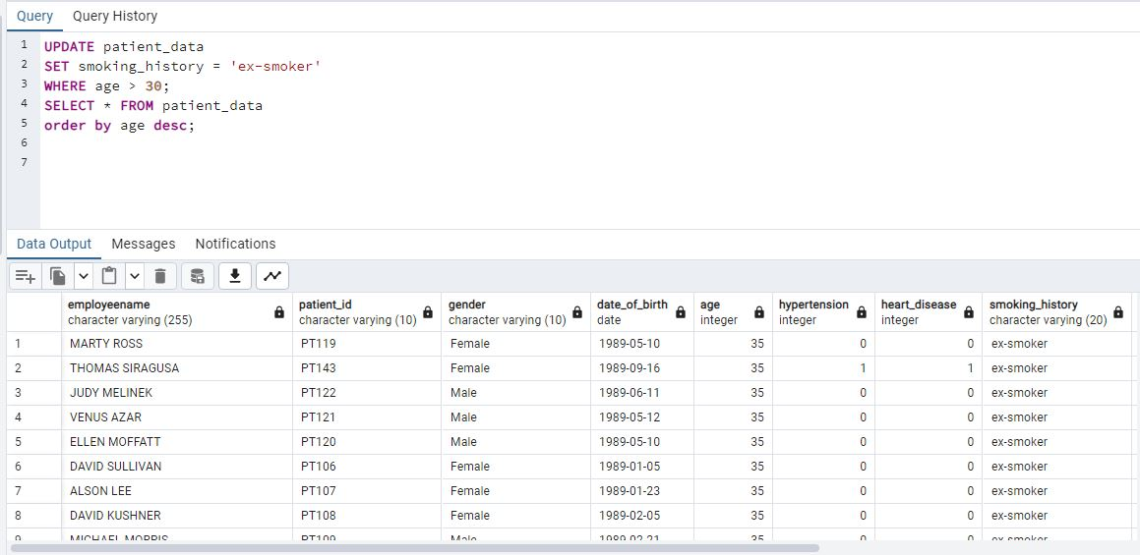
12. Update the smoking history of patients who are older than 40 to "Ex-smoker."

Slide 16
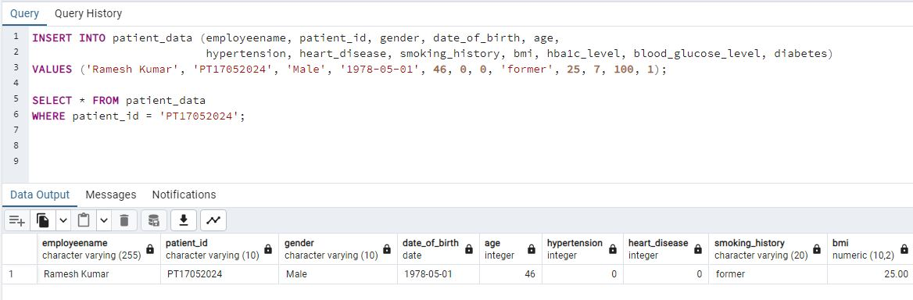
13. Insert a new patient into the database with sample data

Slide 17
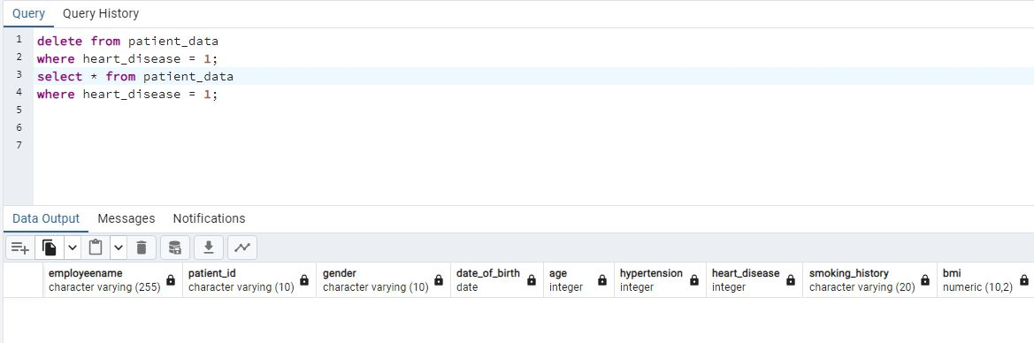
14. Delete all patients with heart disease from the database.

Slide 18
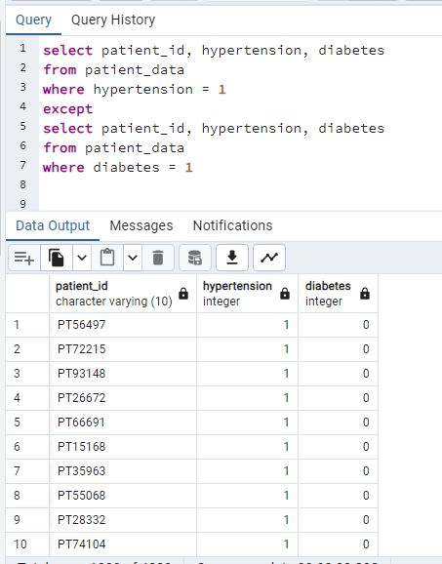
15. Find patients who have hypertension but not diabetes using the EXCEPT operator.

Slide 19
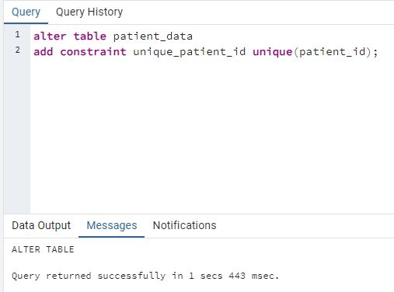
16. Define a unique constraint on the "Patient_id" column to ensure its values are unique.

Slide 20
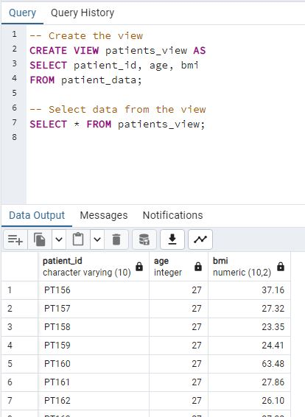
17. Create a view that displays the Patient_id, ages, and BMI of patients.

Slide 21
18. Suggest improvements in the database schema to reduce data redundancy and improve data integrity.
Normalization:
Break down large tables into smaller, related tables to eliminate duplicate data.
Primary Keys:
Ensure each table has a primary key to uniquely identify records.
Data Types and Constraints:
Use appropriate data types.
Apply constraints like NOT NULL and UNIQUE.
Indexing:
Create indexes on frequently queried columns to enhance performance.
Foreign Keys and Referential Integrity:
Define foreign keys to establish relationships between tables.
Implement cascading updates and deletes.
Data Archiving:
Move old data to archive tables to keep main tables efficient.

Slide 22
Composite Keys:
Use composite keys when necessary for unique identification.
Check Constraints:
Enforce specific rules on data values within columns.
Advanced Normalization:
Consider normalizing to BCNF or higher if needed.
Views and Materialized Views:
Create views for simplified data presentation.
Use materialized views for performance on complex queries.
Stored Procedures and Triggers:
Use stored procedures for common operations.
Implement triggers for automatic rule enforcement.
Partitioning:
Partition large tables for better performance and maintenance.
Documentation:
Maintain documentation of the schema, including tables, relationships, and constraints.

Slide 23
19. Explain how you can optimize the performance of SQL queries on this dataset.
Indexing on Patient ID:
Ensure that the Patient_id column, serving as the primary key in the Patients table, is indexed for efficient retrieval of individual patient records
Indexing on Columns Used in WHERE Clauses:
Identify columns frequently used in WHERE clauses, such as age, and apply indexing to accelerate search operations
Covering Index for Common Queries:
Create covering indexes for common queries to include all necessary columns. For instance, if you often query patient details with smoking history, create an index that covers Patient_id, smoking status, and last smoking date

Slide 24
Avoid SELECT :
Select only the columns you need.
Benefit: Minimizes data transfer and processing overhead.
Regular Maintenance Tasks:
Schedule index rebuilds and update statistics regularly.
Benefit: Keeps the database optimized for performance.
Limiting Results and Using WHERE Conditions:
Apply LIMIT clauses when the entire result set is not needed, and use WHERE conditions to filter data efficiently. This reduces the amount of data retrieved and processed.

Slide 25
THANK YOU
https://www.linkedin.com/in/shalini-sharma-02628525b/ -

